Slide 1

A.I.
The Tokyo IP American Inn of Court
July 30, 2020

Slide 2
Agenda
Introduction
  Overview of Artificial Intelligence
  Joshua Cohen
Case Study – Super Office Robot
  Inventors
  Miki Goto
  Mitsuko Miyagawa
  Yasuko Tanaka
  Attorneys
  Takeo Nasu (JP Counsel)
  Joshua Cohen (US Counsel)
  Business Managers
  Kazunari Horiuchi (President)
  Miyako Ikuta (Marketing)
Open Discussion

Slide 3
Overview of AI
Categories
Definition
Computer-implemented system that (1) receives inputs from the environment, (2) learns from or interprets the inputs, and (3) acts to achieve a goal.
Can be “Weak” AI or “Strong” AI.
AI
Machine Learning
Expert Systems
Language Processing
Vision
Robotics
Speech

Slide 4
Overview of AI
Technologies
Deep Learning
AI
Machine Learning
Expert Systems
Language Processing
Vision
Robotics
Speech
Image Recognition
Text Recognition
Robotic Software
Autonomous Vehicles
Speech Recognition
Voice-to-Text Conversion
Decision Trees
(Playing Chess)
Natural Language Processing
Machine Translation

Slide 5
Overview of AI
Diagnosing/Treating Patients
Industries
AI
Healthcare and Medicine
Product Design
Human Resources
Financial Services
Security
Marketing
Facial/Identity Recognition
Detecting Security Risks
Optimizing Investments
Personalizing Advertisements
Identifying Product Features
Identifying Candidates for Hiring

Slide 6
Overview of AI
INPUT
Data Gathering
LEARNING
Algorithm
OUTPUT
User Results
Training Set
Others’ Results
User Requests
Sensors
Machine Learning

Slide 7
Overview of AI
IP Tools
Patent
Computer Systems
User Interfaces
Equipment
Copyright
Computer Programs
Some Data Compilations
Images
Contract
Data License
Software License
Confidentiality
Trade Secret
Data
Algorithms
Know-How

Slide 8
Overview of AI
Patent Filing Statistics

Slide 9

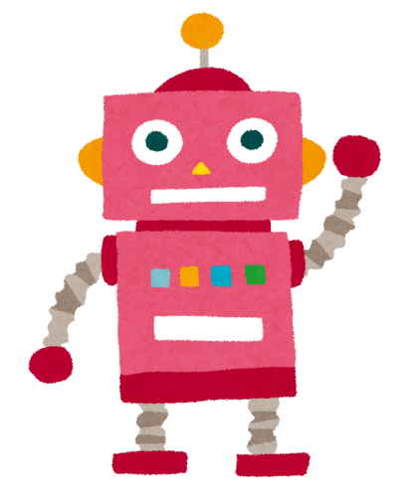
Case Study – Office Robot
Invention Submission
Title: Super office robot
Inventors: Miki Goto, Mitsuko Miyagawa and Yasuko Tanaka
Summary:
Our invention relates to a super office robot using AI technology to help get you through these difficult COVID-19 circumstances.
Key functions and major components of the robot are as follows:

Slide 10
Case Study – Office Robot
Key functions:
It can check your health condition by analyzing various information obtained from your appearance (color of your face, how you look, etc. ) and your body temperature.
It can learn your personality from your appearance and everyday communication.
It can provide what you might want (e.g., serving coffee, serving energy drink, serving candy, switching on/off air conditioner, saying something good, etc.), depending on your personality, your health condition and other circumstances (e.g., temperature, time, etc)
It can do secretary work, such as taking a copy, doing research on court precedents, etc.

Slide 11


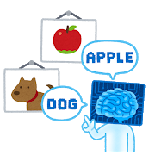
Case Study – Office Robot
Major components of the robot:
  Sensors to detect various information from external world (temperature, images, sounds, etc.)
  Computer program using AI technology
  Big data comprising of various information relating to your personality, your health conditions every day, etc.

Slide 12
Advice from jp counsel
JPO has not changed Examination Guideline
  Patent applications on A.I. related technologies have been already filed and granted properly through examinations.
  The examinations on A.I. related technologies have been conducted without any particular problem based on the current Examination Guidelines and Handbook.
  However, there is a need to clearly show the JPO’s current examination practices for patent applications on IoT related technologies to applicants.
  The JPO added to the Examination Handbook case examples of examination regarding the patentability of A.I. related technologies in 2019.

Slide 13
Advice from jp counsel
Important Bars for A.I. related inventions
Eligibility
Enablement
Novelty and Inventive Step

Slide 14
Advice from jp counsel
Eligibility for Computer Software (including A.I.)
To be patent eligible
Information processing by software must be specifically implemented by using hardware resources (e.g. an arithmetic unit such as a CPU, a storage means such as memory) in the claimed invention.
What is information processing specifically implemented using hardware?
Specifying
  What hardware actors (e.g. an arithmetic unit such as a CPU, a storage means such as memory) are
  What INPUT data and OUTPUT data are
  How the data is specifically processed
  So that information processing can be visualized

Slide 15
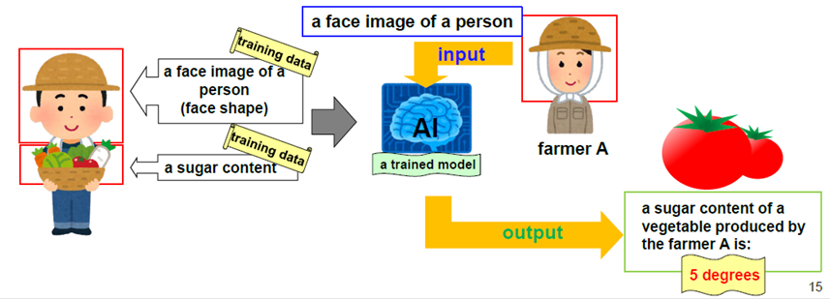
JPO’s Case Example 46
JPO’s website; Newly Added Case Examples for AI-Related Technologies
https://www.jpo.go.jp/e/system/laws/rule/guideline/patent/document/ai_jirei_e/jirei_tsuika_e.pdf
[Claim 1]
A sugar content estimation system comprising:
a storage means for storing face images of people and sugar contents of vegetables produced by the people;
a model generation means for generating a determination model through machine learning, to which a face image of a person is input and from which a sugar content of a vegetable produced by the person is output, using training data containing the face images of the people stored in the storage means and the sugar contents of the vegetables,
a reception means for receiving an input of a face image; and
a processing means for outputting, using the generated determination model that has been generated by the model generation means, a sugar content of a vegetable produced by a person that is estimated based on the face image of the person inputted to the reception means.

Slide 16
Advice from jp counsel
Enablement Requirements
Descriptions of the invention shall be clear and sufficient so as to enable a person skilled in the art to work the invention. (Patent Act, Article 36(4)(i))

Slide 17
Advice from jp counsel
Enablement Requirements
Descriptions of the invention shall be clear and sufficient so as to enable a person skilled in the art to work the invention. (Patent Act, Article 36(4)(i))

Slide 18
Enablement Requirements for Example 46
Overview of Description
It is an object of the present invention to provide a system that estimates a sugar content of a vegetable produced by a person based on his/her face image, taking advantage of the existence of a certain correlation between a face feature of a person and a sugar content of a vegetable produced by the person. For example, a face figure is characterized by a head length, face width, nose width, and lip width as shown in the figure.
Overview of Reason for Refusal
The description only discloses that there is a certain correlation between a face image of a person and a sugar content of a vegetable produced by the person and does not disclose any correlation or the like between them, though disclosing that a face feature is characterized by a head length, face width, nose width, and lip width, for example. It cannot be presumed that there is a correlation or the like between them, even if a common general technical knowledge at the time of filing is taken into consideration. Further, there is no data of examination results of an actually generated determination model shown in the description.
Not meet the enablement requirements

Slide 19
Advice from jp counsel
How to Pursue patent rights for Super Robot
Specify Input and Output => Eligible
Describes 1) a correlation between the Input and Output which a person skilled in the art can understand, or 2) experimental data for proving a correlation between the Input and Output => Meet Enablement Requirements
For example …
Input: drink preference, body temperature, air temperature and current time
Output: serving a preferred drink at a preferred time, e.g. iced tea at 3pm
Correlation: input, drink preference and body temperature of a person, and air temperature, can indicate, output, what the person wants to drink
=> hot temperatures may indicate a person wants to drink a cold drink at tea time

Slide 20
Advice from jp counsel
How to Pursue patent rights for Super Robot
However, novelty and inventive step can be an issue if a correlation is understandable or expectable from inputs because it is not difficult to reach …
A correlation can be understood by a person skilled in the art, but no one has used the input for the output and remarkable technical advantageous effects
Or, a correlation cannot be understood by a person skilled in the art, but experimental data proves that there exists the correlation
not obvious

Slide 21
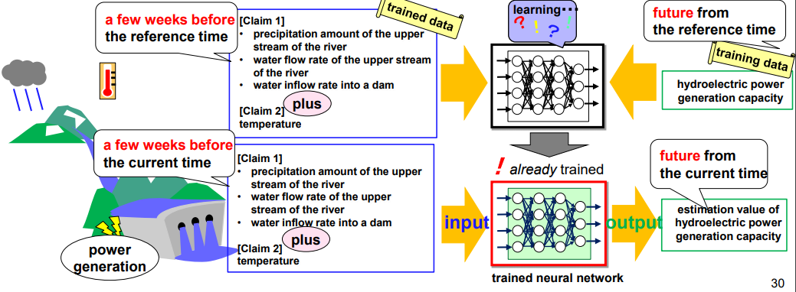
JPO’s Case Example 34
JPO’s website; Newly Added Case Examples for AI-Related Technologies
https://www.jpo.go.jp/e/system/laws/rule/guideline/patent/document/ai_jirei_e/jirei_tsuika_e.pdf
An estimation system of a hydroelectric power generating capacity of a dam

Slide 22
JPO’s Case Example 34
JPO’s website; Newly Added Case Examples for AI-Related Technologies
https://www.jpo.go.jp/e/system/laws/rule/guideline/patent/document/ai_jirei_e/jirei_tsuika_e.pdf
[Claim 1]
An estimation system of a hydroelectric power generating capacity of a dam comprising:
a neural network that is built by means of an information processor, the neural network having an input layer and an output layer, in which an input data to the input layer containing a precipitation amount of the upper stream of a river, a water flow rate of the upper stream of the river, and a water inflow rate into a dam during a predetermined period between a reference time and a predetermined time before the reference time, and an output data from the output layer containing a hydroelectric power generating capacity in the future after the reference time;
a machine learning unit that trains the neural network using a training data corresponding to actual values of the input data and the output data; and
an estimation unit that inputs the input data to the neural network that has been trained by the machine learning unit with setting a current time as the reference time, and then calculates an estimated value of a future hydroelectric power generating capacity based on the output data of which reference time is the current time.
[Claim 2]
The estimation system of a hydroelectric power generating capacity as in Claim 1, wherein the input data to the input layer further contains a temperature of the upper stream of the river during the predetermined period between the reference time and the predetermined time before the reference time.

Slide 23
Advice from jp counsel
Inventive Step for Example 34
Claim 1
Differences b/w Claim 1 and Prior Art, D1
Claim 1: using a neural network having an input layer and output layer
D1: using a regression equation model, but not neural network
=>Easy to apply well known network to D1 so as to reach Claim 1
Lack of Inventive Step

Slide 24
Advice from jp counsel
Inventive Step for Example 34
Claim 2
Differences b/w Claim 2 and D1
Claim 1: input data including a temperature of the upper stream of the river
D1: no disclosures
=> Claim 2 uses an input data containing a temperature of the upperstream of the river during a predetermined period between a reference time and a predetermined time before the reference time. This enables a highly accurate estimation of a hydroelectric power generating capacity, taking an increase of inflow rate due to snow meltwater in the spring into consideration. It is a significant effect beyond the expectation of a person skilled in the art.
Not Obvious

Slide 25
Advice from jp counsel
What should be Input and Output to involve an inventive step??
What should be claimed?
  Patentable type of inventions in Japan
  Program itself (including a learned model)
  Method
  Device or system (robot)
  Method for producing a learned model

Slide 26
Advice from US counsel
Section 101
(Patent Eligibility)
Section 112
(Specification/Claims)
USPTO 2019 Revised Subject Matter Eligibility Guidance (and updates)
Examination of claims “directed to” an “abstract idea”
Indicate an inventive concept such as:
  Improved computer function
  Idea applied to a specific machine
  Transformed article or product
  Something more than just applying an idea to a new technology
Means-Plus-Function Terms
(Section 112(f))
Written Description Requirement
(Section 112(a))
Enablement Requirement
(Section 112(a))
Definiteness Requirement
(Section 112(b))
AI

Slide 27
Advice from US counsel
IP Tool | General Subject Matter | Case Study - Super Office Robot
Patent | New, non-obvious, and useful inventions | Computer programmed with algorithm User interface hardware Electro-mechanical systems
Copyright | Original expressions of ideas | Computer program Compiled data
Contract | Rights and obligations of parties | Data and software licenses Confidentiality & employment agreements
Trade Secret | Secrets having commercial value | Data and algorithm Know-How
Trademark | Source identifiers | Product trademark and service mark Corporate brand

Slide 28
Case Study – Office Robot
Inventors’ Discussion with Counsel
What new intellectual property is found in the Super Office Robot?
Which forms of intellectual property protection may be strongest?
Which forms of intellectual property may be hardest to protect?
Are there major differences between the laws of Japan and the US?

Slide 29
OUR SUPER OFFICE ROBOT
Case Study – Office Robot
Targeted Customers: Any industry but all offices
Targeted Geographical Area: Japan, the US, maybe EU
We may sell/lease robots or we may have a subscription contract with our users.
Number to be sold during the first year: 100 units
Contractual partners:
Subcontractors/manufacturer
Systems engineers
Distributors
Advertising agency, etc.

Slide 30
Case Study – Office Robot
Comments from Business Managers
Which features of the new intellectual property can be protected?
What are the commercially valuable features of this invention?
What is the business plan for commercializing this invention?
How can we “monetize” the Super Office Robot?

Slide 31
Which features of the new intellectual property can be protected?
Case Study – Office Robot
・We would like to prohibit competitors from using robots similar to
Super Office Robot, however, we have to discuss internally before
filing application.
・We have to specify input and output.
・We have to consider novelty and inventive steps.

Slide 32
What are the commercially valuable features of this invention?
Case Study – Office Robot
・We can reduce contact with other people by using the Super Office
Robot.
・We can reduce personnel expenses of employees.
・We can have the Robot check the health conditions of visitors at
shops or event sites.

Slide 33
What is the business plan for commercialization of this invention?
Case Study – Office Robot
・Presently, we don’ t see robots similar to the Super Office Robot available on
the market.
・The Super Office Robot would be a good measure against the spreading COVID-19.
・We anticipate high demand for the Super Office Robot in many countries
including Japan and the US.

Slide 34
How can we “monetize” the Super Office Robot ?
Case Study – Office Robot
・We can sell or lease the robot to many corporations which need
robot employees or event staff.
・We can make a profit from a license agreement with companies that
hope to manufacture robots similar to the Super Office Robot.

Slide 35
Open discussion
How can we best advise clients with A.I. innovations?
What new risks do clients with A.I. innovations face?
What guidance is available from the JPO and USPTO?

